Slide 1

CERTIFICATE III IN AUTOMOTIVE REPAIR & MAINTENANCE
SUBJECT: VEHICLE MAINTENACE AND REPAIR
By Ibrahim siraj
Maldives polytechnic

Slide 2
VEHICLE MAINTENACE AND REPAIR
Chapter 8 Service Ignition System Components
Introduction
A car's ignition system is responsible for igniting the air-fuel mixture in the engine to start and run the vehicle. It uses components like the battery, ignition switch, ignition coil, and spark plugs to create a high-voltage spark at the precise moment needed for combustion. Older systems used mechanical points and a distributor, while modern systems use electronic controls for greater reliability and efficiency.
The purpose of a car's ignition system is to generate a high-voltage electrical spark that ignites the compressed air-fuel mixture within the engine's cylinders, creating the combustion needed to power the vehicle
By Ibrahim siraj
Maldives polytechnic

Slide 3
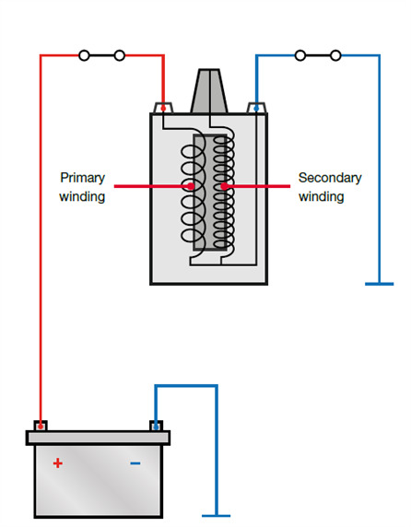
VEHICLE MAINTENACE AND REPAIR
Chapter 8 Service Ignition System Components
How the Ignition System Works
The ignition system functions in two circuits: a primary low-voltage circuit and a secondary high-voltage circuit.
Primary Circuit: The 12-volt current from the car battery flows through the ignition switch and into the primary windings of the ignition coil. This flow of current creates a magnetic field around the coil.
Secondary Circuit: A triggering mechanism (such as breaker points or an electronic sensor) momentarily interrupts the current flow in the primary circuit. This causes the magnetic field to collapse rapidly, which induces a very high voltage (up to 40,000 to 100,000 volts in modern systems) in the secondary windings of the coil.
Distribution and Ignition: This high voltage is then directed to the appropriate spark plug in the correct cylinder at the precise moment (timing is crucial for engine performance). The voltage arcs across the gap at the tip of the spark plug, creating a powerful spark that ignites the air-fuel mixture, causing combustion and forcing the piston down.
By Ibrahim siraj
Maldives polytechnic

Slide 4
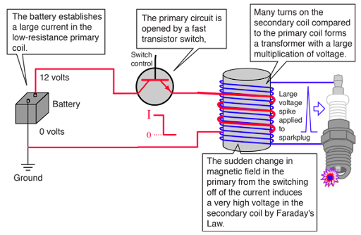
VEHICLE MAINTENACE AND REPAIR
Chapter 8 Service Ignition System Components
How the Ignition System Works
The ignition system functions in two circuits: a primary low-voltage circuit and a secondary high-voltage circuit.
By Ibrahim siraj
Maldives polytechnic

Slide 5
VEHICLE MAINTENACE AND REPAIR
Chapter 8 Service Ignition System Components
Key Components
The main components of an ignition system typically include:
Battery: Provides the initial low-voltage electrical energy to power the system.
Ignition Switch: Controls the flow of electricity from the battery to the rest of the ignition system, allowing the driver to start the car.
Ignition Coil: Acts as a transformer, converting the battery's low voltage into the extremely high voltage needed for the spark plugs.
Spark Plugs: Located in the engine cylinders, these devices generate the actual spark that ignites the air-fuel mixture.
Distributor (in older systems): A mechanical device that routes the high-voltage current from the coil to each spark plug in the correct firing order. This system also uses points and a condenser.
Engine Control Unit (ECU) / Ignition Module (in modern systems): In modern cars, an ECU or ignition module uses sensors (like crankshaft and camshaft position sensors) to determine the precise ignition timing electronically, eliminating the need for a mechanical distributor
By Ibrahim siraj
Maldives polytechnic

Slide 6
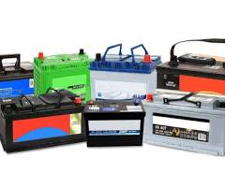
VEHICLE MAINTENACE AND REPAIR
Chapter 8 Service Ignition System Components
Key Components
The main components of an ignition system typically include:
Battery: Provides the initial low-voltage electrical energy to power the system.
A vehicle battery is a rechargeable energy source that stores chemical energy and converts it into electrical energy to start a vehicle and power its electrical components, such as lights, radio, and air conditioning
Primary function: To provide the high electrical current needed to start the engine and power the starter motor.
Secondary function: To power all electrical accessories (like lights, wipers, and the radio) and regulate voltage, especially when the engine is off or when electrical demand is high.
By Ibrahim siraj
Maldives polytechnic

Slide 7
VEHICLE MAINTENACE AND REPAIR
Chapter 8 Service Ignition System Components
Key Components
The main components of an ignition system typically include:
Ignition Switch: Controls the flow of electricity from the battery to the rest of the ignition system, allowing the driver to start the car.
A vehicle ignition switch is a crucial electrical component that controls the car's power systems, from turning on accessories like the radio to starting the engine.
It functions as the central control for starting the car, directing power from the battery to the starter motor and other essential systems like the ignition and fuel systems. In modern vehicles, it also communicates with anti-theft systems, using a key fob with a push-button start or a coded key for a traditional ignition
By Ibrahim siraj
Maldives polytechnic

Slide 8
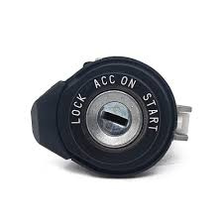
VEHICLE MAINTENACE AND REPAIR
Chapter 8 Service Ignition System Components
Key Components
The main components of an ignition system typically include:
Ignition Switch: Controls the flow of electricity from the battery to the rest of the ignition system, allowing the driver to start the car.
Powers accessories: In different modes (e.g., "ACC" or "ON"), the switch powers various vehicle accessories such as the radio, power windows, and air conditioning.
Starts the engine: When turned to the "START" position, it sends a powerful electrical charge from the battery to the starter motor to crank the engine and initiate the ignition process.
Controls vehicle power: It acts as the main switch to turn the vehicle's entire electrical system on and off.
Enhances security: Modern ignition switches often incorporate security features that require a coded key or a compatible key fob to be present before the engine will star
By Ibrahim siraj
Maldives polytechnic

Slide 9
VEHICLE MAINTENACE AND REPAIR
Chapter 8 Service Ignition System Components
Key Components
The main components of an ignition system typically include:
Ignition Switch: Controls the flow of electricity from the battery to the rest of the ignition system, allowing the driver to start the car.
Types of ignition switches
Key-operated: A traditional switch that requires a physical key to be turned, often with multiple positions like LOCK, ACC, ON, and START.
Push-button: A more modern version where a button activates the ignition after the system verifies the presence of a coded key fob, which communicates wirelessly with the ca
By Ibrahim siraj
Maldives polytechnic

Slide 10
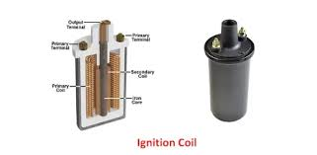
VEHICLE MAINTENACE AND REPAIR
Chapter 8 Service Ignition System Components
Key Components
The main components of an ignition system typically include:
Ignition Coil: Acts as a transformer, converting the battery's low voltage into the extremely high voltage needed for the spark plugs.
A vehicle's ignition coil is an electrical transformer that converts the car's low-voltage battery power into the high voltage needed to create a spark at the spark plugs.
This high-voltage spark ignites the air-fuel mixture in the engine's cylinders, which is essential for internal combustion and a vehicle's operation. Modern vehicles typically have a coil-on-plug system with an individual coil for each spark plug.
By Ibrahim siraj
Maldives polytechnic

Slide 11
VEHICLE MAINTENACE AND REPAIR
Chapter 8 Service Ignition System Components
Key Components
The main components of an ignition system typically include:
Ignition Coil: Function
Function: It acts as a transformer, stepping up the 12 volts from the battery to a much higher voltage, often between 15,000 and 45,000 volts.
Mechanism: The coil uses electromagnetic induction. It contains two wire windings, a primary and a secondary, wrapped around an iron core. When the electrical current in the primary winding is interrupted, the collapsing magnetic field induces a high voltage in the secondary winding.
Purpose: This high voltage is sent to the spark plug, where it creates the electrical arc needed to ignite the fuel-air mixture, initiating combustion.
Modern systems: Instead of a single coil for the entire engine as in older cars, most modern vehicles use individual ignition coils for each cylinder, a setup known as coil-on-plug. This system is more reliable and efficiency
By Ibrahim siraj
Maldives polytechnic

Slide 12
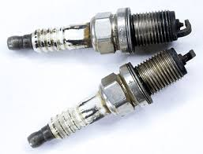
VEHICLE MAINTENACE AND REPAIR
Chapter 8 Service Ignition System Components
Key Components
The main components of an ignition system typically include:
Spark Plugs: Located in the engine cylinders, these devices generate the actual spark that ignites the air-fuel mixture.
A vehicle spark plug is a crucial component that ignites the air-fuel mixture in an internal combustion engine by creating an electrical spark
This spark causes a controlled explosion that drives the engine's pistons, generating the power to move the vehicle. Essentially, spark plugs are the source of ignition for a gasoline engine to start and run
By Ibrahim siraj
Maldives polytechnic

Slide 13
VEHICLE MAINTENACE AND REPAIR
Chapter 8 Service Ignition System Components
Key Components
The main components of an ignition system typically include:
Spark Plugs: Function
Function: Spark plugs deliver a high-voltage jolt from the ignition system to the engine's combustion chamber. The spark jumps the gap between two electrodes, igniting the compressed mixture of air and fuel.
Role in power generation: This ignition creates a small explosion that pushes the piston down, which is the first step in the engine's cycle that ultimately results in the vehicle's movement.
Other functions: Besides creating the spark, spark plugs also help dissipate heat from the combustion chamber and remove combustion byproducts.
Maintenance: Spark plugs wear out over time due to the millions of explosions they create. Signs of a failing spark plug include difficulty starting, rough idling, and poor fuel economy. Regular checking during a car service is recommended
By Ibrahim siraj
Maldives polytechnic

Slide 14
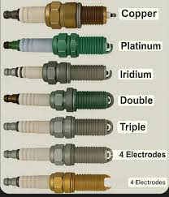
VEHICLE MAINTENACE AND REPAIR
Chapter 8 Service Ignition System Components
Key Components
The main components of an ignition system typically include:
Spark Plugs: Types
The main types of spark plugs are copper, platinum, double platinum, and iridium
By Ibrahim siraj
Maldives polytechnic

Slide 15
VEHICLE MAINTENACE AND REPAIR
Chapter 8 Service Ignition System Components
Key Components
The main components of an ignition system typically include:
Spark Plugs: Types
The main types of spark plugs are copper, platinum, double platinum, and iridium
Copper: Features a copper core with a nickel-alloy outer material. They provide high conductivity and heat transfer but wear out faster, making them suitable for older or high-compression engines.
Platinum: Has a platinum disc welded to the center electrode, which resists heat and wear better than copper. They last longer and are ideal for modern engines with electronic ignition systems.
Double Platinum: Features platinum on both the center and ground electrodes. This design is specifically for "waste spark" ignition systems and has an even longer lifespan than single platinum plugs.
Iridium: Made from a stronger, more durable metal with a higher melting point than platinum. Their key feature is a very fine center wire, which allows for better electrical energy conduction and a more efficient spark, resulting in improved combustion. They are the most durable option, best for newer and high-performance vehicle
By Ibrahim siraj
Maldives polytechnic

Slide 16
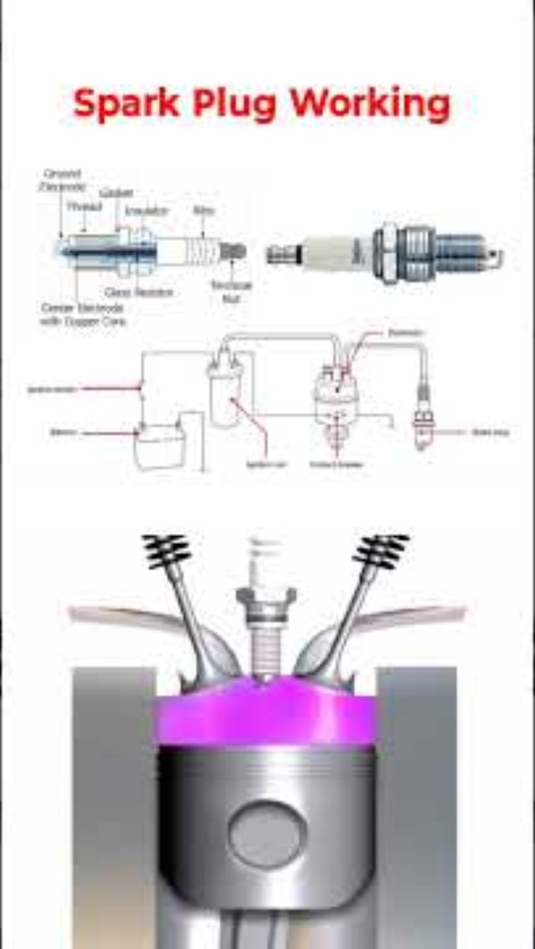
VEHICLE MAINTENACE AND REPAIR
Chapter 8 Service Ignition System Components
Key Components
The main components of an ignition system typically include:
Spark Plugs: Located in the engine cylinders, these devices generate the actual spark that ignites the air-fuel mixture.
By Ibrahim siraj
Maldives polytechnic

Slide 17
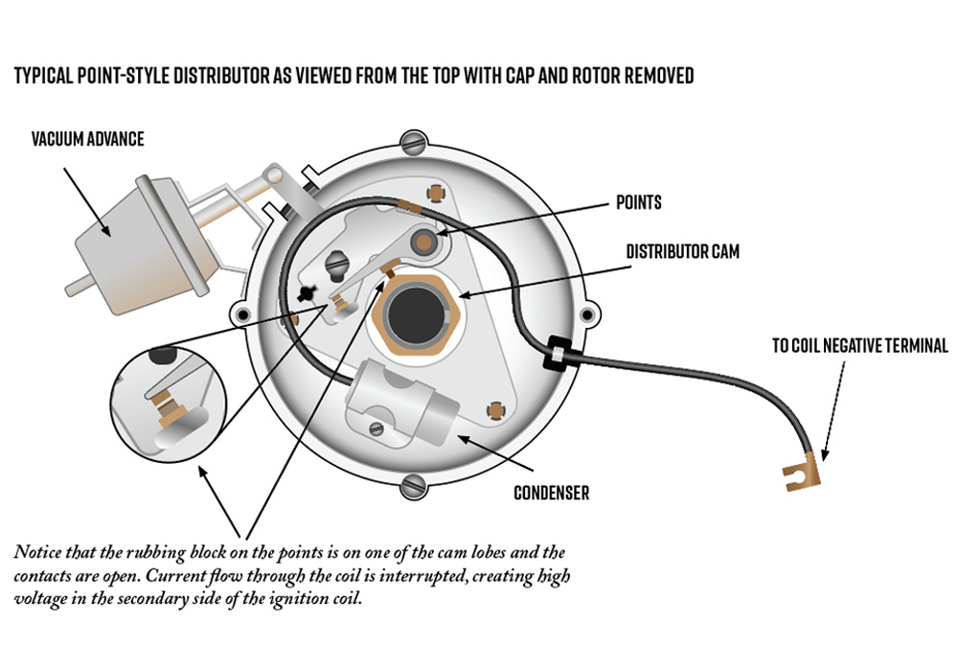
VEHICLE MAINTENACE AND REPAIR
Chapter 8 Service Ignition System Components
Key Components
Distributor (in older systems): A mechanical device that routes the high-voltage current from the coil to each spark plug in the correct firing order. This system also uses points and a condenser.
An ignition distributor is a mechanical device in older car engines that routes high-voltage sparks from the ignition coil to the correct spark plug at the precise time for combustion.
It consists of a rotating rotor inside a distributor cap that distributes the electrical current to the spark plugs in the proper firing order. This process is now handled electronically by the vehicle's computer in modern cars
By Ibrahim siraj
Maldives polytechnic

Slide 18
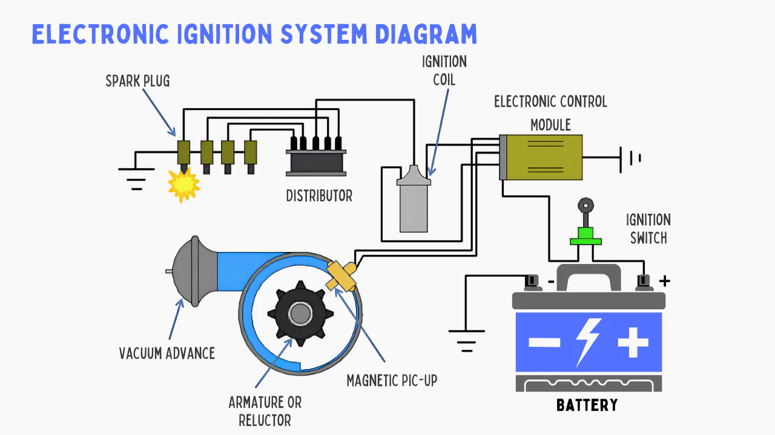
VEHICLE MAINTENACE AND REPAIR
Chapter 8 Service Ignition System Components
Key Components
The main components of an ignition system typically include:
By Ibrahim siraj
Maldives polytechnic

Slide 19
VEHICLE MAINTENACE AND REPAIR
Chapter 8 Service Ignition System Components
Types of Ignition Systems
Ignition systems have evolved over time to improve efficiency, reliability, and performance.
Conventional Breaker-Point Ignition: The oldest type, relying on mechanical breaker points and a condenser within the distributor to open and close the primary circuit. These systems require frequent maintenance.
Electronic Ignition System: Replaced mechanical points with solid-state electronics and sensors for more reliable operation and less maintenance. It still used a distributor to route the spark.
Distributor less Ignition System (DIS): Eliminates the distributor entirely, using multiple ignition coils (one for every pair of cylinders). Timing is controlled by the engine computer, improving accuracy and reducing moving parts.
Coil-On-Plug (COP) System: The most advanced type, where an individual ignition coil sits directly on top of each spark plug. This design maximizes spark energy, improves fuel economy, and removes the need for spark plug wires, further enhancing reliability.
By Ibrahim siraj
Maldives polytechnic

Slide 20
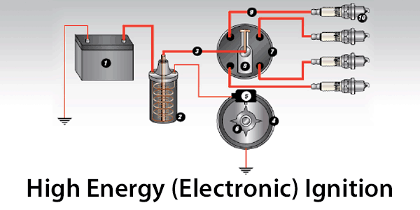
VEHICLE MAINTENACE AND REPAIR
Chapter 8 Service Ignition System Components
Types of Ignition Systems
Ignition systems have evolved over time to improve efficiency, reliability, and performance.
Conventional Breaker-Point Ignition: The oldest type, relying on mechanical breaker points and a condenser within the distributor to open and close the primary circuit. These systems require frequent maintenance.
By Ibrahim siraj
Maldives polytechnic

Slide 21
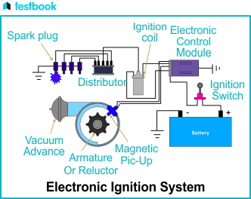
VEHICLE MAINTENACE AND REPAIR
Chapter 8 Service Ignition System Components
Types of Ignition Systems
Ignition systems have evolved over time to improve efficiency, reliability, and performance.
Electronic Ignition System: Replaced mechanical points with solid-state electronics and sensors for more reliable operation and less maintenance. It still used a distributor to route the spark.
An electronic ignition (EI) system is a modern automotive system that precisely controls spark timing using electronic components instead of mechanical ones.
By Ibrahim siraj
Maldives polytechnic

Slide 22
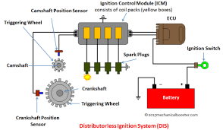
VEHICLE MAINTENACE AND REPAIR
Chapter 8 Service Ignition System Components
Types of Ignition Systems
Ignition systems have evolved over time to improve efficiency, reliability, and performance.
Distributor less Ignition System (DIS): Eliminates the distributor entirely, using multiple ignition coils (one for every pair of cylinders). Timing is controlled by the engine computer, improving accuracy and reducing moving parts.
A distributorless ignition system (DIS) is a modern car ignition system that eliminates the mechanical distributor, using electronic controls to deliver spark directly to the spark plugs via individual coils or a coil pack.
By Ibrahim siraj
Maldives polytechnic

Slide 23
VEHICLE MAINTENACE AND REPAIR
Chapter 8 Service Ignition System Components
Types of Ignition Systems
Ignition systems have evolved over time to improve efficiency, reliability, and performance.
Coil-On-Plug (COP) System: The most advanced type, where an individual ignition coil sits directly on top of each spark plug. This design maximizes spark energy, improves fuel economy, and removes the need for spark plug wires, further enhancing reliability.
How it works
Individual coils: Each cylinder has a dedicated ignition coil that sits directly on top of the spark plug, sometimes connected by a rubber boot.
ECU control: The Engine Control Unit (ECU) receives information from various sensors (like the crankshaft and camshaft position sensors) to determine the precise moment to fire each coil.
Individual firing: The ECU sends a signal to a specific coil, which generates a high-voltage spark to ignite the air-fuel mixture in that cylinder. This is different from older systems that used a single coil and a distributor to send the spark to each plug
By Ibrahim siraj
Maldives polytechnic

Slide 24
VEHICLE MAINTENACE AND REPAIR
Chapter 8 Service Ignition System Components
Types of Ignition Systems
A coil-on-plug (COP
Key advantages
Improved performance: More precise, stronger sparks lead to better combustion, which can increase power and improve the engine's response.
Greater efficiency: Individual coil control and more reliable firing can result in better fuel economy and lower emissions.
Enhanced reliability: By removing spark plug wires, COP systems eliminate potential issues like voltage drops and wear over time. If one coil fails, only that coil needs to be replaced, not all of them.
Longer service life: Many modern COP systems can use high-durability iridium or platinum spark plugs that last much longer than older copper plug
By Ibrahim siraj
Maldives polytechnic

Slide 25
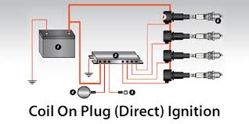
VEHICLE MAINTENACE AND REPAIR
Chapter 8 Service Ignition System Components
Types of Ignition Systems
A coil-on-plug (COP
Key advantages
By Ibrahim siraj
Maldives polytechnic

Slide 26
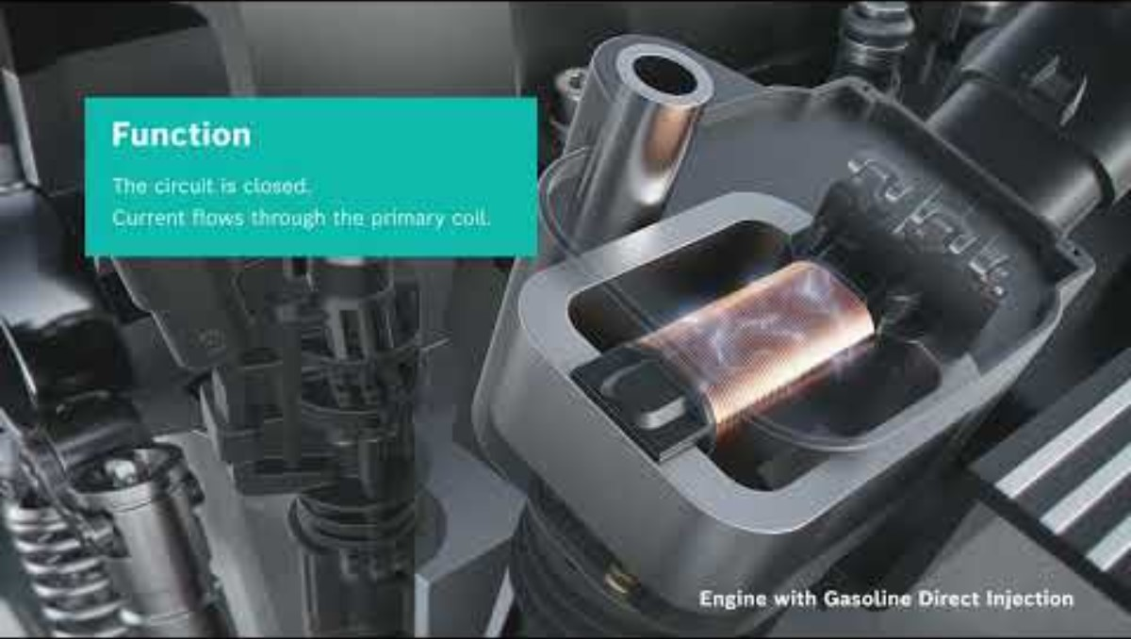
VEHICLE MAINTENACE AND REPAIR
Chapter 8 Service Ignition System Components
Types of Ignition Systems
A coil-on-plug (COP
Key advantages
By Ibrahim siraj
Maldives polytechnic

Slide 27
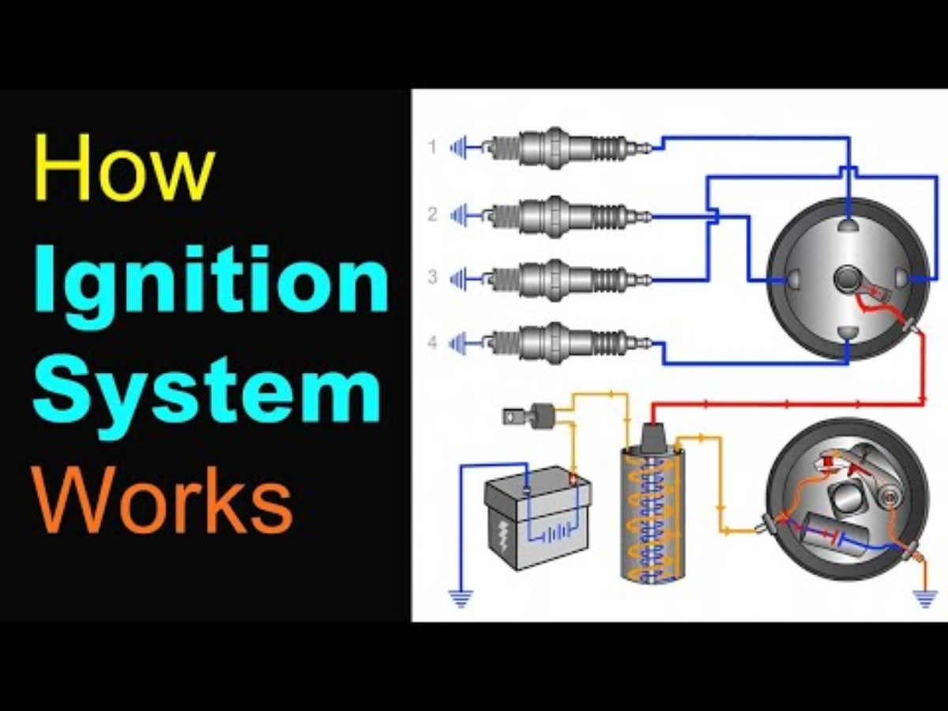
VEHICLE MAINTENACE AND REPAIR
Chapter 8 Service Ignition System Components
Types of Ignition Systems
A coil-on-plug (COP
By Ibrahim siraj
Maldives polytechnic

Slide 28
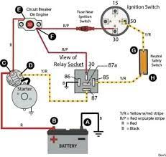
VEHICLE MAINTENACE AND REPAIR
Chapter 8 Service Ignition System Components
Types of Ignition Systems
A coil-on-plug (COP
By Ibrahim siraj
Maldives polytechnic

Slide 29
THANK YOU

